Slide 1


Remote work Survey Dashboard Project

Slide 2







The Team

Slide 3

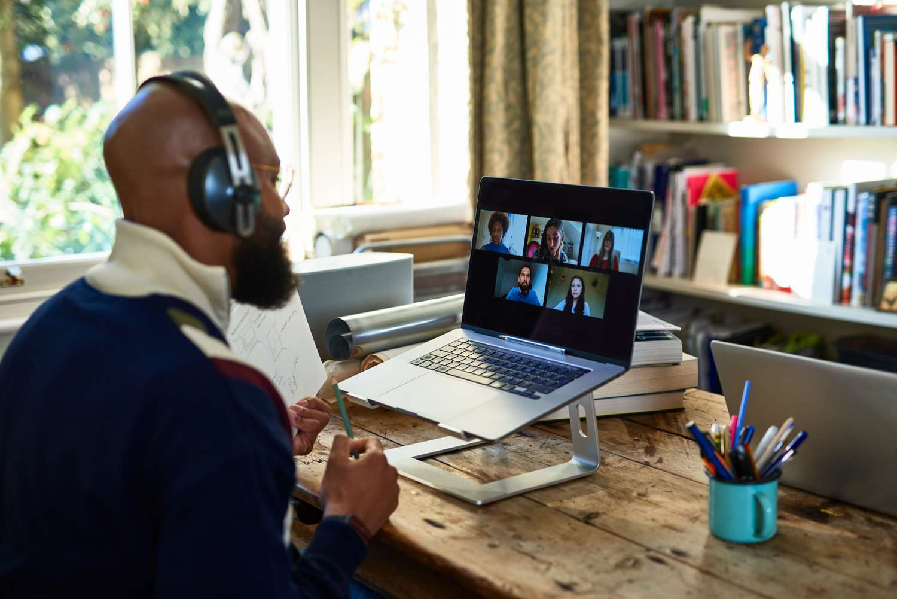
About Dataset
Survey results of 1,500 remote workers
From the Australian state of New South Wales
Taken in August-September 2020.
Aimed to capture the shift in remote work experiences and attitudes during different stages to gain insights on its long-term implications.

Slide 4

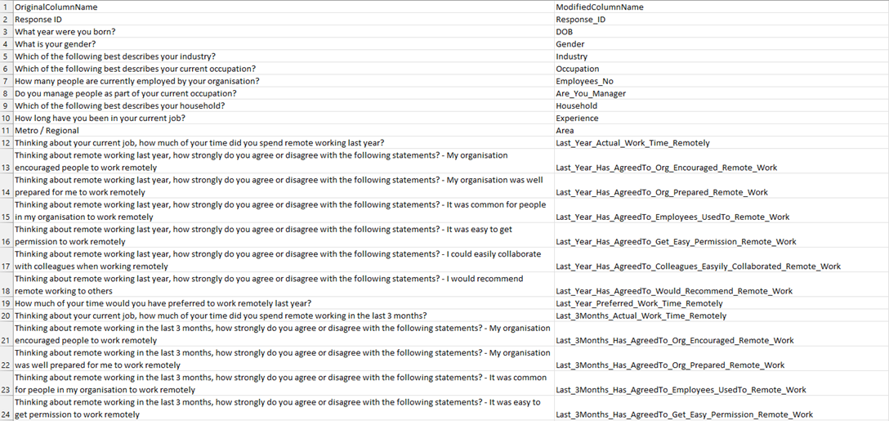
Prepare The Dataset
1. Data Import & Validation
With Excel we handled columns names as it was too long to fit as a column name in SQL DB, and not unified, so We copy names of columns, which were the questions of the survey, and used transpose feature and put the column names in a new sheet and make new names for columns, referring to the old names.

Slide 5


The Naming Guidelines Used to modify
Meaningful Names
Consistency
Avoided Reserved Keywords
Used Snake Case Style
Prefixing and Suffixing like Data Type Prefixes
Abbreviations and Acronyms
Avoided Uncommon Abbreviations and Used Standard Acronyms
Naming Conventions for Specific Data Types like Boolean Columns and Numeric Columns
Documentation
Commenting

Slide 6
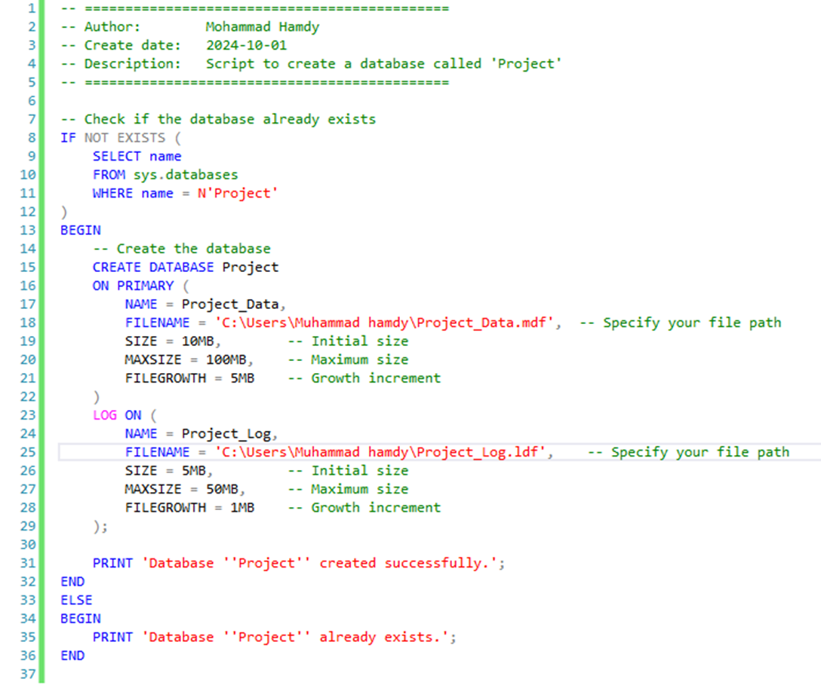
2. Creating Database:

Slide 7
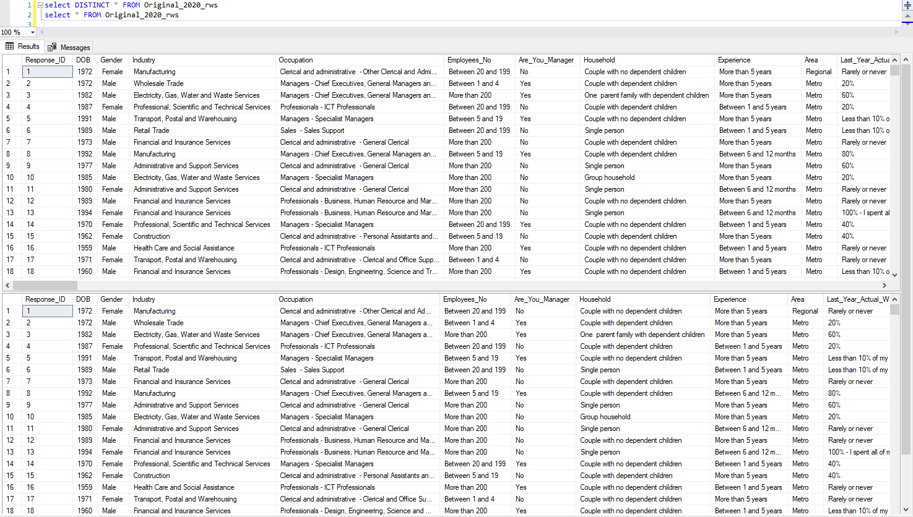
3. Data Cleaning
Check for Duplicates to Remove Them:

Slide 8
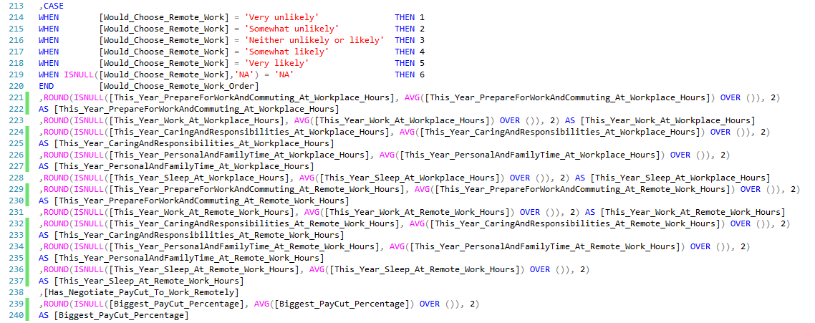
Handle Null Values:

Slide 9
Standardize Formats:
Remove Unlogic Outliers:

Slide 10
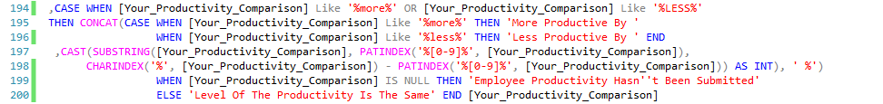
4. Data Transformation
Create New Columns/Derived Values:

Slide 11
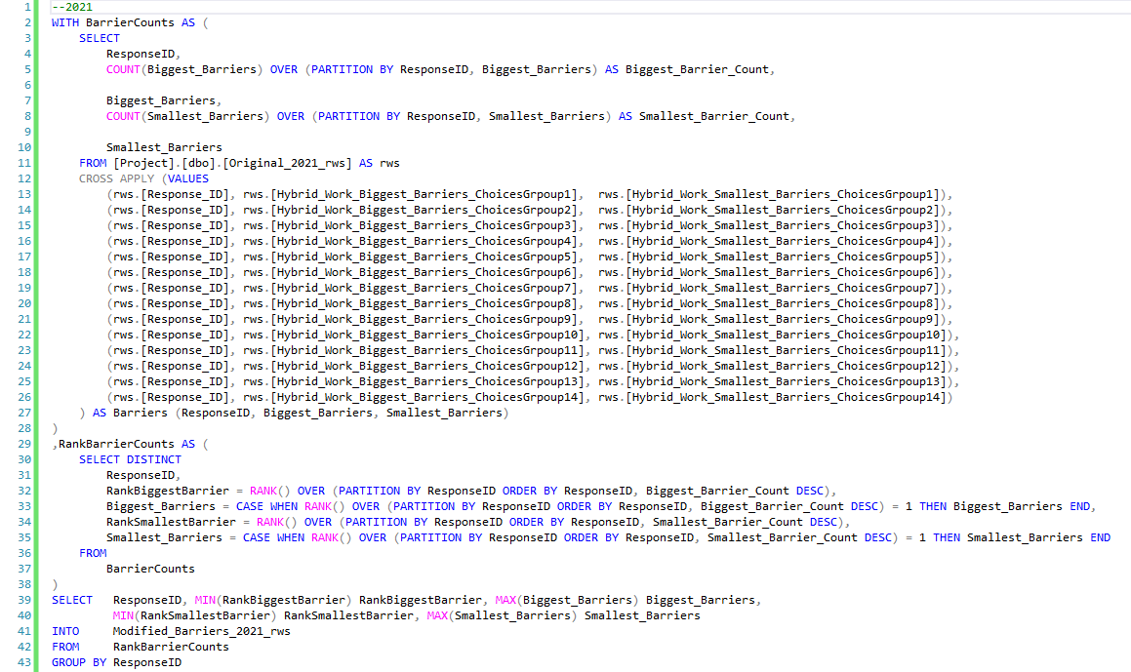
Data Aggregation and arrangement

Slide 12
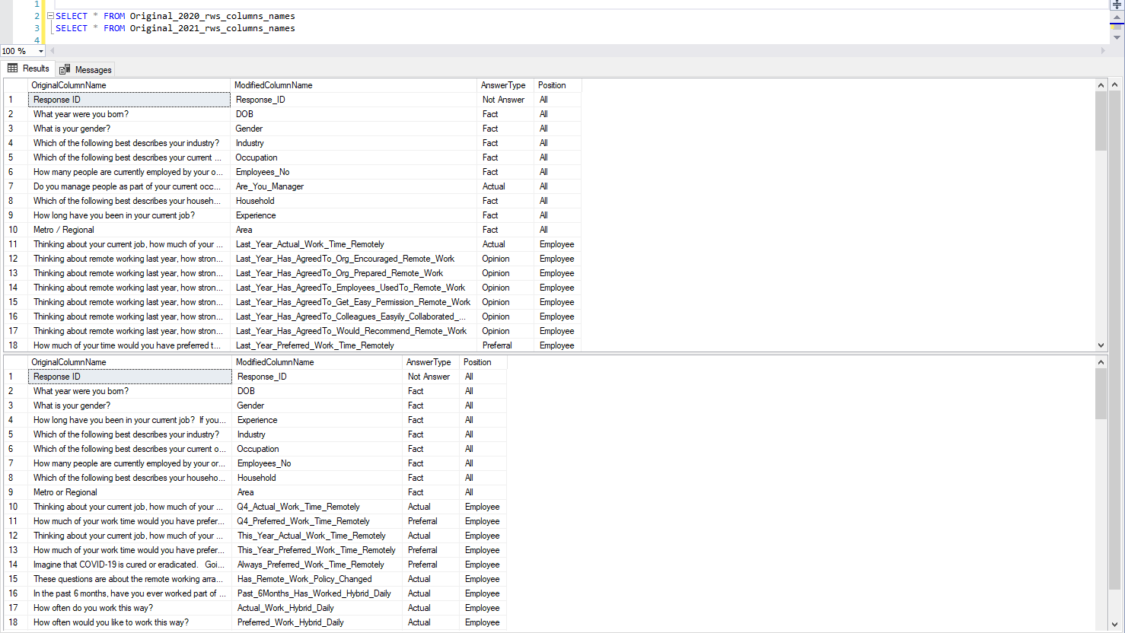
5. Data Enrichment
Add Lookup Tables:

Slide 13
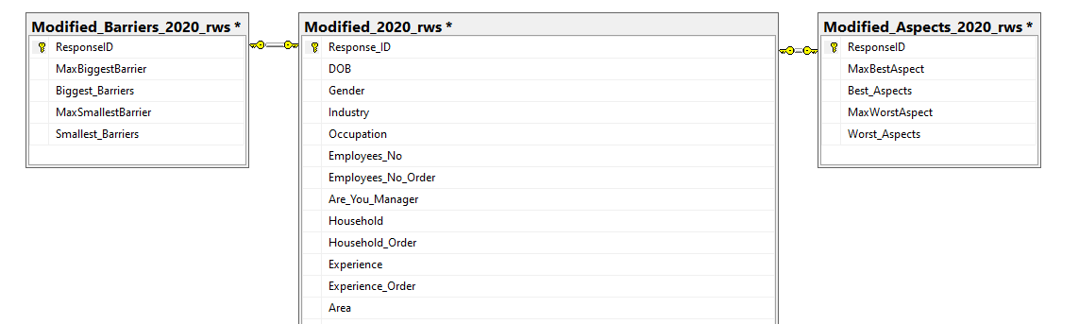
6. Data Integrity Checks
Foreign Key and Referential Integrity:
Data Validation Rules:

Slide 14
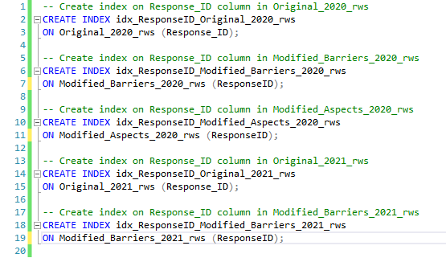
7. Performance Optimization
Indexes:

Slide 15
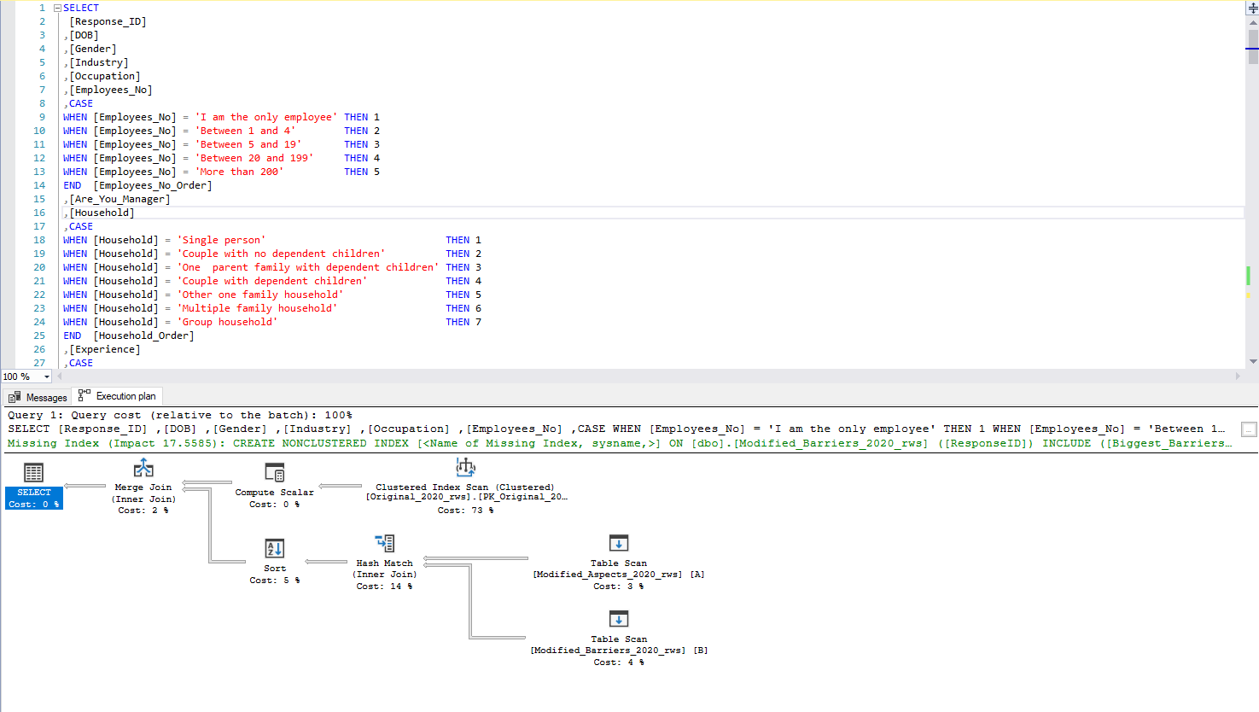
Query Optimization:

Slide 16
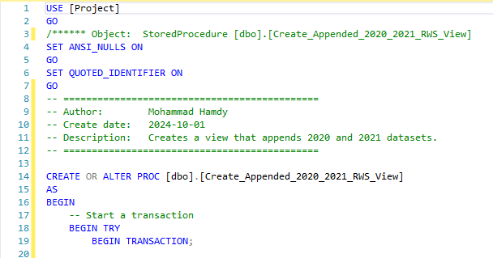
8. Create Views/Stored Procedures

Slide 17
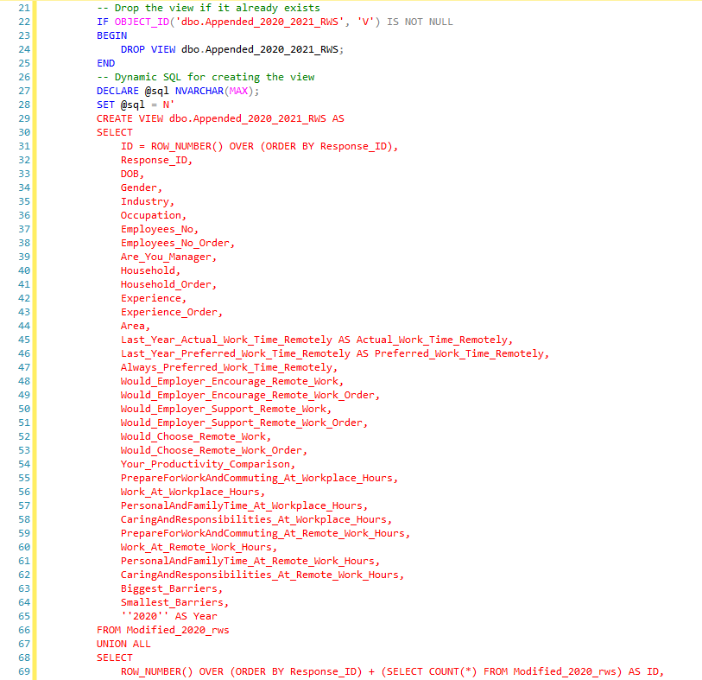

Slide 18
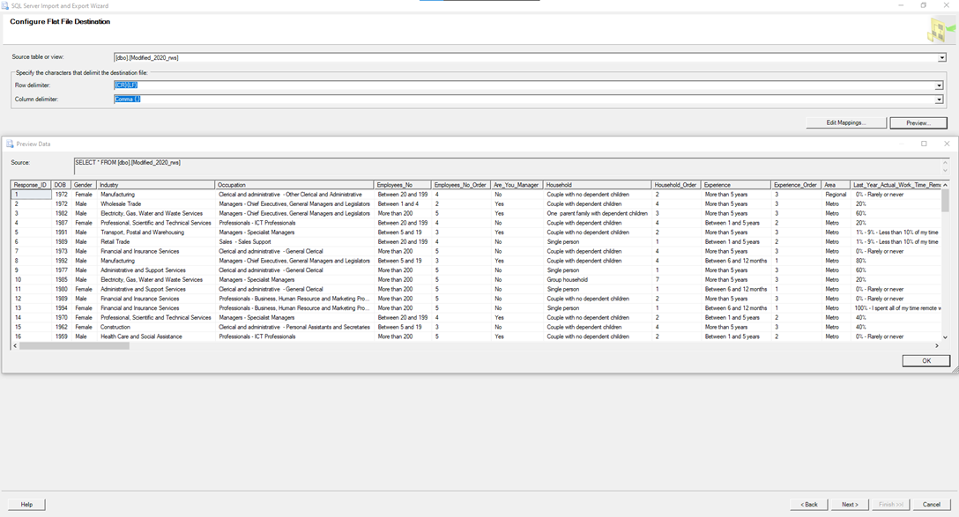
9. Export Dataset for Tableau

Slide 19

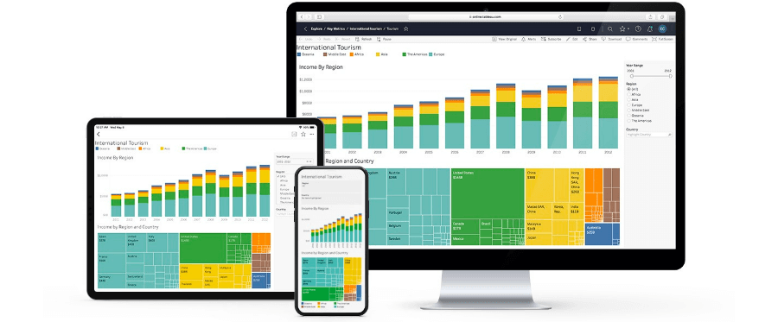
Design the Dashboard Using Tableau

Slide 20
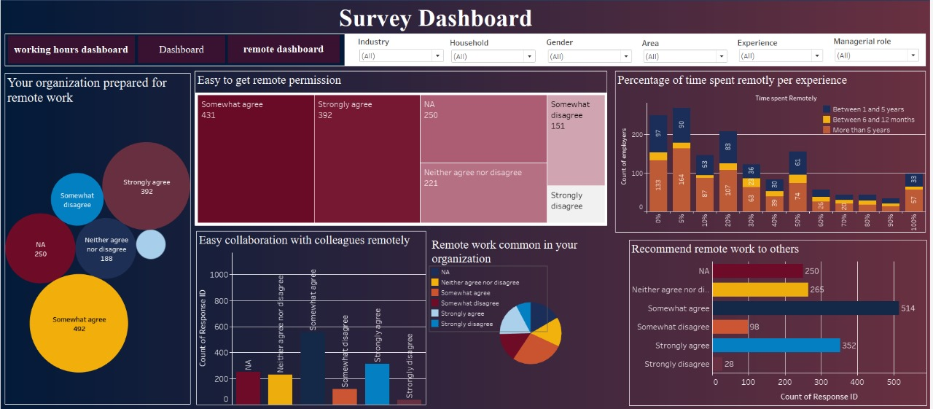
Approval for Remote Work:

Slide 21
Organization Preparedness for Remote Work:
Strongly Agree (392) and Somewhat Agree (492) make up the majority, indicating that many respondents believe their organization is prepared for remote work.
A smaller portion of the respondents are either neutral (188) or believe their organization is not prepared (Somewhat Disagree: 250).
Insight: The majority of the surveyed employees feel their organizations are prepared for remote work, but there is a notable group that remains neutral or disagrees, suggesting room for improvement in organizational preparedness.

Slide 22
Ease of Getting Remote Work Permission:
A large portion of respondents either Somewhat Agree (431) or Strongly Agree (392) that it's easy to get permission for remote work.
Fewer respondents expressed neutral views (221) or disagreed (Somewhat Disagree: 151, Strongly Disagree: a small percentage).
Insight: Most employees find it relatively easy to get remote work permission, although some struggle with obtaining it, indicating possible inconsistencies in company policies or management practices.

Slide 23
Percentage of Time Spent Remotely by Experience:
Employees with 1-5 years of experience are more likely to work 100% remotely compared to those with more than 5 years of experience.
There’s a strong presence of newer employees (1-5 years) in the high remote work percentages (80%-100%), indicating that remote work is more common among less experienced employees.
Insight: More experienced employees (5+ years) are distributed across lower percentages of remote work, suggesting they may either prefer hybrid models or have roles that require more in-office time.

Slide 24
Ease of Collaboration with Colleagues Remotely:
A significant number of respondents find collaboration somewhat easy (strong agreement: 392), but there are still a few who disagree.
Insight: Collaboration during remote work is generally perceived as positive, but for some employees, it remains a challenge, indicating a need for better tools or practices to support remote teamwork.

Slide 25
Remote Work Commonality in the Organization:
Strongly Agree (392) and Somewhat Agree (492) dominate, showing that remote work is becoming common in these organizations.
Insight: The trend of remote work is increasingly normalized across organizations, although some employees still report that it's not as prevalent, possibly in more traditional sectors.

Slide 26
Recommendation of Remote Work to Others:
The highest count comes from those who Somewhat Agree (514) and Strongly Agree (352) with recommending remote work to others.
A smaller group disagrees (Somewhat Disagree: 98, Strongly Disagree: 28).
Insight: Most employees are likely to recommend remote work to others, indicating general satisfaction, though a small group remains unsatisfied.

Slide 27
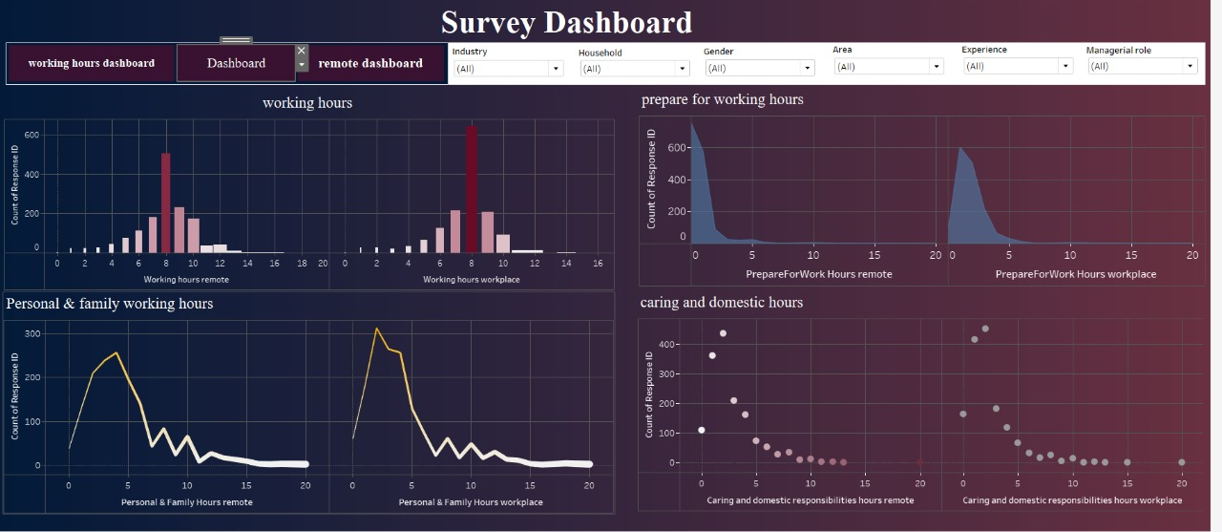
Remote Working hours VS workplace

Slide 28
Working Hours (Remote vs. Workplace):
Remote Working Hours:
The most common working hours remotely seem to be concentrated around 8 hours per day, with a peak at this value.
There's also a distribution of people working fewer hours remotely (around 6-7 hours), but the majority still works 8 hours remotely.
Workplace Working Hours:
A similar pattern is seen for on-site (workplace) working hours, where the majority of employees report working 8 hours in the workplace.
There's a slight spread to longer and shorter hours, but 8 hours seems to be the standard in both remote and workplace setups.

Slide 29
Personal & Family Working Hours (Remote vs. Workplace):
Remote:
A significant number of people dedicate 3 to 5 hours to personal and family responsibilities while working remotely.
The curve drops after this, indicating fewer people spend over 6-7 hours on family-related tasks while working remotely.
Workplace:
For those working on-site, the number of personal and family hours is considerably lower, with most people spending 1 to 2 hours during workdays. The distribution also drops sharply after that.

Slide 30
Preparing for Working Hours (Remote vs. Workplace):
Remote:
Most people spend very little time preparing for remote working hours. The graph shows a peak around 1 hour or less.
Workplace:
For on-site work, the preparation time is more spread, with a notable peak around 1-2 hours, reflecting more time spent commuting or getting ready for the workplace compared to remote work.

Slide 31
Caring and Domestic Responsibilities (Remote vs. Workplace):
Remote:
Employees working remotely spend more time on caring and domestic responsibilities, with a notable spread up to 20 hours in some cases, but most responses fall around 1-5 hours.
Workplace:
In the workplace setting, the time spent on these responsibilities is much lower, concentrated mostly in the 0-3 hour range, indicating that domestic tasks are much less of a focus during traditional on-site workdays.

Slide 32
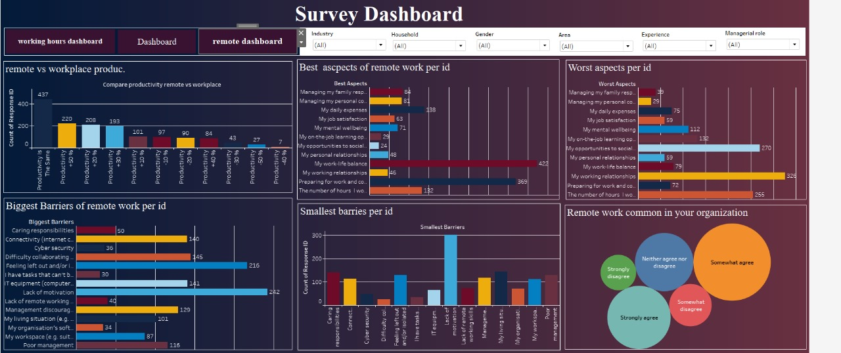
Productivity in Remote vs Workplace

Slide 33
Comparison of Productivity in Remote vs Workplace Settings:
A significant number of respondents (437) indicated that their productivity is about the same when working remotely as in the workplace.
However, 220 respondents reported being 10-30% more productive remotely, followed by 208 respondents who felt 10-30% less productive remotely.
Insight: Fewer respondents reported extreme productivity differences, whether positive or negative, suggesting that most workers find a slight productivity change when working remotely.

Slide 34
Biggest Barriers to Remote Work:
Caring responsibilities (216 respondents) and connectivity issues (145 respondents) are highlighted as the top barriers to remote work.
Other prominent barriers include difficulty collaborating (122 respondents) and challenges with IT equipment (121 respondents).
Management discouraging remote work (116 respondents) and workspace issues are also notable barriers, emphasizing challenges related to both personal and organizational factors.

Slide 35
Best Aspects of Remote Work:
Work-life balance (422 respondents) is overwhelmingly seen as the best aspect of remote work.
Other key positive aspects include preparing for work and commuting less (365 respondents), and better personal relationships (48 respondents), indicating the lifestyle benefits remote work offers.
Additionally, mental well-being and job satisfaction are highlighted by a smaller portion of respondents, showing that remote work positively affects certain personal factors.

Slide 36
Worst Aspects of Remote Work:
While work-life balance is viewed positively, 270 respondents struggle with opportunities to socialize, making this the most commonly reported negative aspect.
Work-life balance can also be a challenge for 79 respondents, likely indicating a need for better boundary management.
Mental well-being (132 respondents) and preparing for work/commute (255 respondents) also appear in the "worst" list, showing that some remote workers face challenges despite the benefits.

Slide 37
Smallest Barriers to Remote Work:
Caring responsibilities and cybersecurity issues are seen as the smallest barriers, indicating they are less problematic for many respondents.
The results indicate there is less concern about feeling left out and tasks that cannot be done remotely, with fewer respondents viewing these as significant barriers.

Slide 38
Remote Work Perception in Organizations:
A significant portion of respondents somewhat agree that remote work is common in their organization, followed by strong agreement.
This distribution suggests that while remote work is present, there is still some variance in its adoption across organizations.

Slide 39


